Slide 1
Supporting Student Success for Students with Disabilities in Post-Secondary Education
Roksana Sobota, Lead SAS Program Coordinator
Sherry Beduk, Lead SAS Program Coordinator
Notes:
Sherry

Slide 2
Land Acknowledgement
We acknowledge the traditional territories upon which we gather today; McMaster University is located on the traditional territories of the Mississauga and Haudenosaunee nations, and within the lands protected by the “Dish with One Spoon” wampum agreement.”
Notes:
Sherry
As a non indigenous person myself, I am committed to listen and understand the voices of indigenous staff, students and community members to try to understand their history of oppression and ways we can work better together to reduce power imbalances. I also acknowledge that I am in a position of power within SAS and work with students with disabilities who often identify with other intersectionalities who have lived with oppression for most of their lives. I am committed to ensure that students voices are heard in our process and it is collaborative so that we can develop an individualized plan that works for each student. When students identify that others are disempowering them, or denying their needed accommodations, I will speak up to ensure that power doesn’t limit a students success. This is our commitment at SAS and I hope you all think of ways that you can reduce power dynamics in the institutions that you work.

Slide 3
Activity
Where is your home base?
Notes:
Sherry

Slide 4
Menti
What do you think is the percentage of students who identify with a disability who are enrolled in University?
a) 5%
b) 15%
c) 30%
d) 45%
Notes:
Roksana

Slide 5
Enrollment of Students with Disabilities
According to the Higher Education Strategy Associates in The State of Postsecondary Education in Canada 2023 report, enrollment in post-secondary education for students identifying with a disability has risen to 31% of the population across Canada in 2022.
Notes:
Roksana In 2016, the wording of this question changed to explicitly include mental health issues and the proportion of self-reporting students shot up to 22%.
Attendance of students with disabilities in PS education has risen significantly over the past 20 years-we need to make changes to ensure the campus space, curriculum and attitudes promote inclusion, and acceptance to ensure all students can participate and feel like they belong.

Slide 6
What is Student Accessibility Services?
At Student Accessibility Services (SAS), we provide individualize accessibility services for students with disabilities.
This includes:
Academic accommodations
Transition programming
Accessible testing centre
Assistive technology and learning strategies
Notes:
Sherry

Slide 7
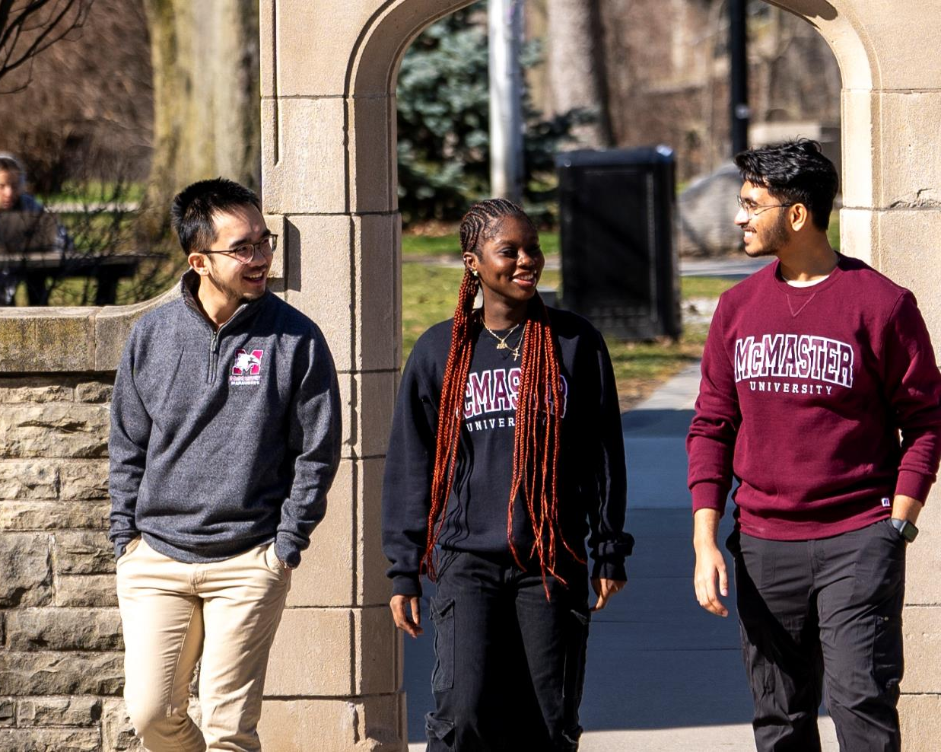
What is Student Accessibility Services?
Accommodation decisions meet the OHRC principles-using an individualized approach to accommodations that removes/mitigates disability barriers, to allow for full integration and participation in the university community, while maintaining and respecting the dignity of the student with the disability

Slide 8
Who does Student Accessibility Services support?
Any student that identifies with a disability that impacts their academic functioning or participation within specific aspects of their education are eligible
Includes permanent disabilities, and temporary disabilities, and students with interim needs while they wait for further assessment.
McMaster supports students in all levels of their education including undergraduate, graduate, CCE and professional programs
Notes:
Sherry

Slide 9
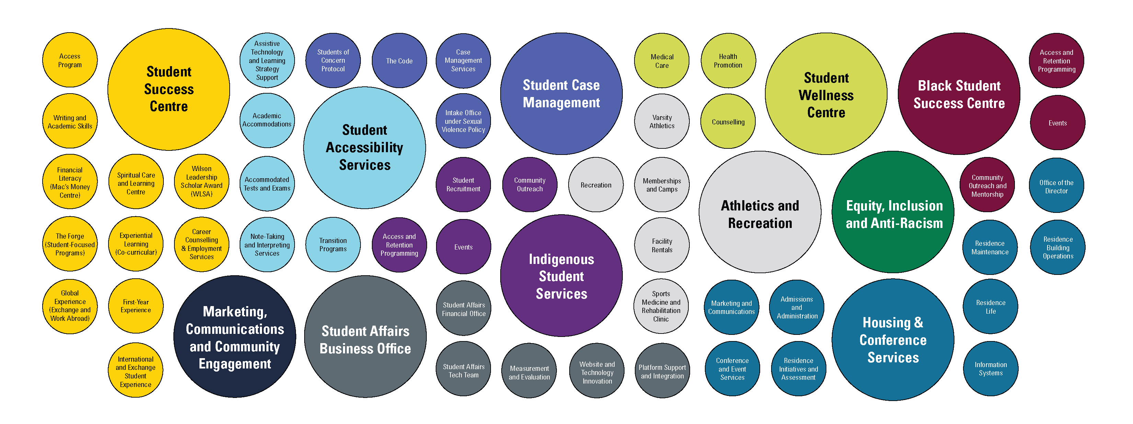
Student Affairs
McMaster University
Notes:
Roksana

Slide 10
Considering intersectionality when working with students with disabilities
Multiple identities
Unique challenges
Inclusive practices/policies
Representation matters.
Notes:
Roksana
https://www.linkedin.com/pulse/intersectionality-disability-inclusion-breaking-trish-robichaud-wbnyf

Slide 11
Why intersectionality matters
Video-Intersectionality and disability, Keri Gray
Notes:
Roksana
I also like this video-Intersectionality & disability, ft Keri Gray, the Keri Gray Group #DisabilityDemandsJustice (youtube.com)

Slide 12
Case Example #1
A first-year, Indigenous student is starting in the Life Sciences program. The student experiences chronic pain as well as vision loss. The student also uses a cane to support their mobility.
Notes:
Sherry to introduce #1

Slide 13
Mentimeter
What type of barriers do you think this student might face?
Notes:
Review barriers group identified together

Slide 14
Case Example #2
A third year, mature student is enrolled in Chemical Engineering. Student has had frequent hospitalizations due to mental health concerns and is needing to withdraw from 3/5 classes due to the amount of missed work.
Notes:
Roksana to introduce #2

Slide 15
Mentimeter
What type of barriers do you think this student might face?
Notes:
Review barriers group identified together

Slide 16
Barriers that students with disabilities may face at Post Secondary Institutions
Physical
Attitudinal
Organizational/Systemic
Financial
Social/Communication
Notes:
Sherry-reflect on audience identification of barriers, although there is many different categories, we will focus on these 5 areas
Physical-also talk about sensory barriers-poor acoustics/lack of amplification-students who are hard of hearing, overstimulating environments for students with MH/ADHD, trauma and lack of calming spaces to support self regulation, lack of consistent physical markers for blind/low vision students or limited notice for changes e.g. contruction, events that change the physical markers; closing pathways e.g. winter time that are regular navigation routes-
https://accessiblecampus.ca/understanding-accessibility/

Slide 17
What can we do to reduce or minimize barriers in our institutions?
Reflection on two case examples
2022 Ontario report: recommendations to make PS Education more accessible for people with disabilities by 2025
Always see the person first, not the disability
Be an ally-speak up when you see acts of microaggression/barriers to accessibility
Notes:
Roksana?
What can we do to mitigate the barriers. Reflect on the two examples and what could have been done
Case example number 1: a couple of things that we could think about:
Case example number 2“

Slide 18
What can we do to reduce or minimize barriers in our institutions?
Enhance staff/faculty training-disability and intersectionality awareness/inclusion
Review and adjust policies/processes with a disability/inclusion lens
Ensure all documents, websites, and workshops you offer meet accessibility standards
Ensure you receive the student voice/feedback regarding ways to improve inclusion in your campus space
Notes:
Sherry

Slide 19
Advice from the experts: student voice
“Think of the student with a disability as a person first and not the policies/ procedures that need to be followed. Building that relationship and having dialogues is crucial , so that the experience is collaborative. It made me feel that I was a part of the university and not just a number,” Yvonne
“Be compassionate and understanding. There is such a wide variety of disabilities that exist, and they aren't all visible (or common). This means that you may not know which students are struggling, what they are struggling with, or how it impacts their lives,” Jasmine
“Take all accessibility concerns seriously. Often times students' concerns are dismissed because the faculty/staff believe that they know what is best for the students. The fact of the matter is that you can never understand someone's disability more than they do,” John
Notes:
-Sherry-Quote or video from the student ambasadors

Slide 20
Specific Considerations for Aids/Awards Offices
OSAP/Funding Options
Accessibility of space, documents
Access to appointments
Sensitivity to disability information
Student's need for medical leave of absences
Consideration for additional supports for students with disabilities
Notes:
OSAP/Funding options-Roksana
Accessibility of space and documents provided to students
Access to appointments
Attitudes: they have the ODVF, respecting the dignity of the student in their office space, pre-assumptions that may be made
Medical leave of absences
Meeting with a Financial Aid Advisor in person
The time commitment No support with completing the applications,
Process/ procedures/ accessing the services

Slide 21
MENTI
What is your institution already doing to make your space welcoming and inclusive for students with disabilities?
Notes:
Roksana

Slide 22
Reflection
What is one thing you will do differently in your work to support students with disabilities that come through your doors?
Notes:
Sherry: We encourage you to look at your Province's legislation, to look into your own University accessibility policies and practices, training and supports available
Talk about this topic in your staff meetings to determine how you can make your space more accessible and more welcoming to students

Slide 23
Resources
Ontario Post Secondary Education Standards Final Recommendation Report 2022
Assessment of debt load and financial barriers affecting students with disabilities in Canadian Post Education Ontario Report
The State of Postsecondary Education in Canada 2023
Higher Education Strategy Associates
Enhancing Accessibility in Post Secondary Education Institutions

Slide 24
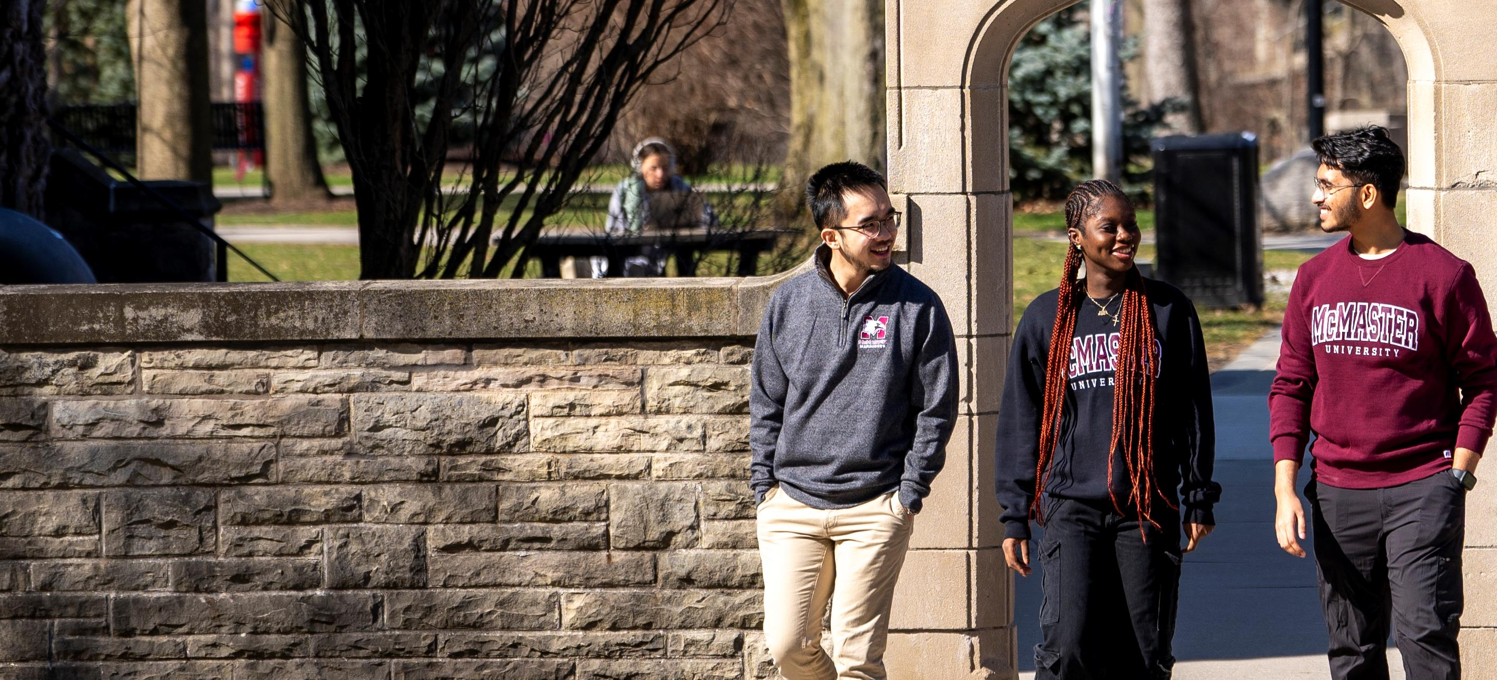
Thank You!

