Slide 1
Redesign of the University of Toronto's Advanced Planning for Students (UTAPS) Program
CASFAA Presentation: June 4, 2024
Donna Wall, Associate University Registrar & Director, Financial Aid & Awards
Jennifer Da Silva, Associate Director, Financial Aid

Slide 2
Background
UTAPS (University of Toronto Advanced Planning for Students) – U of T's largest need-based support program
Entitlement program to fund unmet need based on OSAP need assessment methodology
Operating budget of up to $50M and endowed/expendable funds of up to $2M​
UTAPS framework is set out in Governing Council’s Policy on Student Financial Support (1998) to ensure that U of T meets its funding guarantee
“No student offered admission to a program at the University of Toronto should be unable to enter or complete the program due to lack of financial means”

Slide 3
Background – cont’d.
UTAPS is for domestic students only
OSAP recipients (i.e., Ontario residents) were automatically considered
Government student aid recipients from other Canadian provinces and territories, and students receiving Indigenous education funding (i.e., sponsorship funding) applied for UTAPS
OSAP need assessment (with modifications) was used to calculate UTAPS grants, which fund unmet need. Ontario and out-of-province students are assessed using the same methodology
International students and domestic students not in receipt of government student aid are not eligible

Slide 4
Background – cont’d.
OSAP funding is a combination of loans and grants from Ontario and Canada. Each level of government determines its need assessment policy
Annual policy changes may cause unmet need variability from one year to the next, which impacts annual UTAPS expenditures
Annually, staff in the University Registrar’s Office and Planning and Budget review and analyze OSAP policy changes for the upcoming academic year to:​
Assess the reasonableness of one government’s policy over another when determining the UTAPS need assessment
Project UTAPS expenditures against the program’s budget
To qualify for a UTAPS grant, domestic government student aid recipients had to have unmet need according to the OSAP need assessment
Unmet need occurred when a student receives the maximum amount of OSAP available but still has financial need above the OSAP funding maximums

Slide 5
Challenges with UTAPS
Sensitivity to government decision-making and timelines
UTAPS budget is set months before OSAP policy changes are announced
OSAP policy changes impact student need/unmet need, and ultimately, UTAPS expenditures
To ensure financially needy students received UTAPS, in some years UofT provided in-year top-ups to UTAPS grant funding, regardless of the OSAP need assessment
Timing of UTAPS does not allow for advanced planning
UTAPS was designed to be an “advanced planning” tool for students and their families to help them financially plan for the academic year ahead
For many years, the UTAPS process occurred in-year, after classes started and after the drop/add date

Slide 6
Challenges with UTAPS – cont’d.
Lack of transparency​
Students didn’t know …​
How UTAPS is calculated.
Whether they’re eligible.
How much they will receive (eligible students)
When they will receive it
Accessibility and equity
Only about 22%-25% of OSAP recipients received UTAPS
Students in high-cost programs are more likely to receive UTAPS than those in regular fee programs
High-cost programs (e.g., engineering): education costs > max OSAP available
Regular fee programs (e.g., history): education costs < max OSAP available
As per Ministry data, U of T has a higher percentage of direct entry students from low-income families (gross income < $70k) than other Ontario universities. Most of these students are in regular fee programs

Slide 7
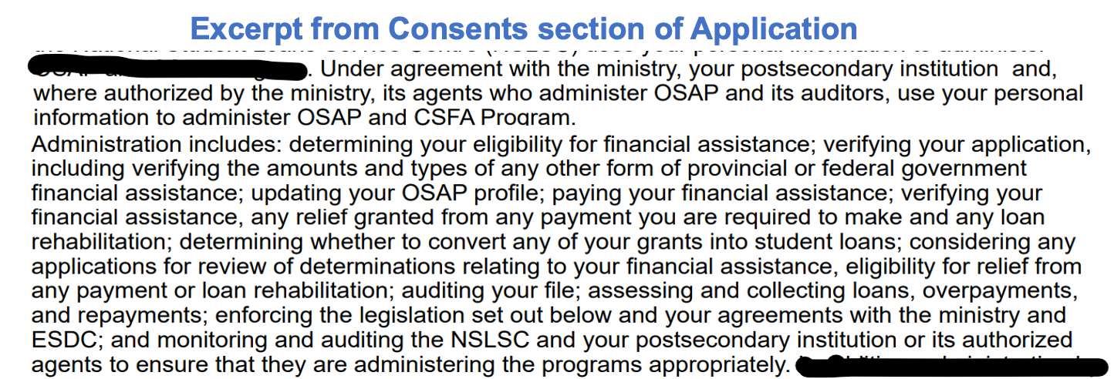
Challenges with UTAPS – cont’d.
OSAP consents and data use
OSAP Application for Full-Time Students limits the use of student-submitted data for purposes other than administration of OSAP
As a result, de-centralized institutions (e.g., University of Toronto) cannot use OSAP data to better support students
Collecting relevant information directly from students through our own internal application allows us to better meet their financial needs

Slide 8
Modernized UTAPS and Financial Aid at U of T – What should it look like?
Predictable model for institutional planning, modelling/forecasting, budgeting
UTAPS for students with unmet need​ not just those in high-cost programs; ​not just for OSAP recipients
OSAP for data validation only, not the basis for actual UTAPS expenditures
UTAPS should not replace government student aid obligations​
Transparent processes and policies
Streamlined costs and resources to assess financial need
Estimate of UTAPS funding as part of the admission offer for incoming students
Provide a funding guarantee months before the start of Fall term

Slide 9
Input from Student Advisory Group to get a sense of what students may want in a modernized UTAPS program
This is what we heard...

Slide 10
Student feedback about UTAPS changes
"It is reasonable to expect students to complete an application to determine their financial need"
Any application should be simple, easy-to-understand, short, and accessible for all students
Students who do not apply should still be eligible for some need-based funding
"Financial resources should be considered when determining financial need"
Students earning income through employment while studying should not be disadvantaged
Students with merit-based scholarships should receive less need-based awards
"Students should be advised early of any potential need-based awards"
Ideally, students should be advised of their potential awards when determining which school to attend

Slide 11
Redesign: Phase I
2023-24
Financial Need Assessment + new UTAPS Application developed
Streamlined need assessment for domestic students (undergraduate/graduate)
UTAPS calculation – UTAPS entitlements based on information provided by the student, UTAPS data model, and U of T created expense tables
Eliminated need for:
Out-of-Province UTAPS Estimator
School of Graduate Studies Financial Need Estimator
OSOTF/OTSS applications
Excel and manual processes (in most cases)

Slide 12
Redesign: Phase I – cont’d.
All domestic students complete an application for UTAPS through the new Need Navigator tool
Students only submit one financial need application per academic year
Financial need for UTAPS consideration = Allowable education and living costs (MINUS) Resources from expected contributions and government financial aid program
Minimum UTAPS = SAG (i.e., $100): values <$100 rounded up; Maximum UTAPS = no limit
UTAPS financial need assessment will:
Use realistic costs of attending school at U of T (e.g., residence costs, transportation)​
Improve transparency as resources and costs are known to students and divisions​
Increase accessibility and equity as students in regular fee and high-cost programs are assessed using the same methodology
Financial need assessment shared with divisions to help them administer their own need-based aid
URO will evaluate the redesign to understand more about the student experience, and continue to make improvements to the program
UTAPS financial need assessment will:
Reflect actual costs of attending school at U of T (e.g., residence costs, transportation)
Improve transparency as actual resources and costs will be known to students and divisions
Increase accessibility and equity as students in regular fee and high-cost programs will be assessed using the same methodology
Financial need assessment will be shared with divisions
URO will conduct an evaluation of the redesign to understand more about the student experience, and continue to make improvements to the program
All domestic students (residents from Ontario and other Canadian jurisdictions) will be required to complete an application through the Need Navigator tool for UTAPS consideration

Slide 13
UTAPS Need Assessment Formula
UTAPS = (100% x Educational Need) + (X% x Non-Educational Need)
Educational Need = (Tuition + Fees) – (Resources [Funding from Government Student Aid Program + Scholarships + Assets + Student Contribution + Parental Contribution])
Non-Educational Need = (Living Allowance + Transportation) - (Remaining Resources from Educational Need)

Slide 14
Expenses and Resources - Assumptions
Expenses | Resources | Need
Tuition + ancillary/incidental fees Books and supplies Living allowance Public transit | Student contribution Parental contribution Government student aid program funding Assets Merit-based scholarships | Education Non-education

Slide 15
Living expense and resource categories (2023-24)
Category | $ per Month | Source
Away from Home – UTSG | $ 1,857 | CMHC + OSAP
Away from Home – UTSC | $ 1,718 | CMHC + OSAP
Away from Home – UTM | $ 1,691 | CMHC + OSAP
At Home | $ 511 | OSAP
Married | $ 2,340 | OSAP
Sole Support Parent | $ 1,587 | OSAP
Per Dependent Child | $ 652 | OSAP
Public Transportation | $ 135 | MiWay
Student Contribution | $ 450 | OSAP
Parental Contribution | Variable | TBD
Notes: ​
Away from home costs include monthly assumptions for food ($286) and miscellaneous expenses ($306)​
Rental cost assumptions by campus are: UTSG = $1,265; UTSC = $1,126; UTM = $1,099​
Costs will be updated on an annual basis, as appropriate (e.g., CMHC / OSAP)

Slide 16
2023-24: UTAPS Recipients
 | Number of students who received UTAPS | UTAPS Paid | Average per student
Ontario students | 9,318 | $ 36.8M | $ 3,950
Out-of-Province students | 565 | $ 2.4M | $ 4,250
Total | 9,883 | $ 39.2M | $ 3,960

Slide 17
How is UTAPS different than OSAP?
OSAP
UTAPS
Application driven
Application renewals
Standardized need assessment based on province; thresholds to contain costs; weekly funding max
Income validation process with CRA
Robust appeals
Calculation fixed each year
Limitations on use of OSAP data
Application driven; no renewals; no appeals...for now
More generous need assessment
More realistic living costs based on GTA, per campus
Actual tuition regardless of program
No funding limit
Validation check against OSAP data
Agile Need Assessment process
U of T database of financial need data
Financial information sharing with divisions to support their administration of need-based aid
Consolidate and standardize need-based assessment and forms across University

Slide 18
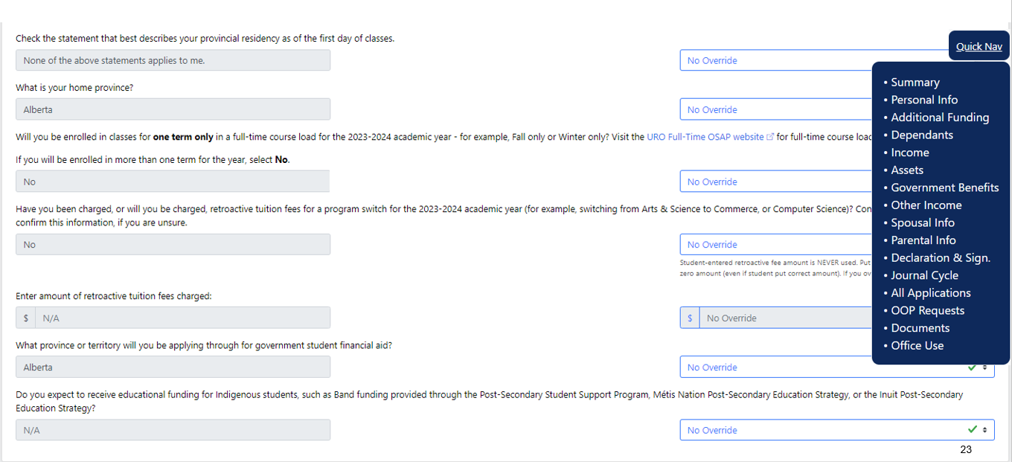

Slide 19
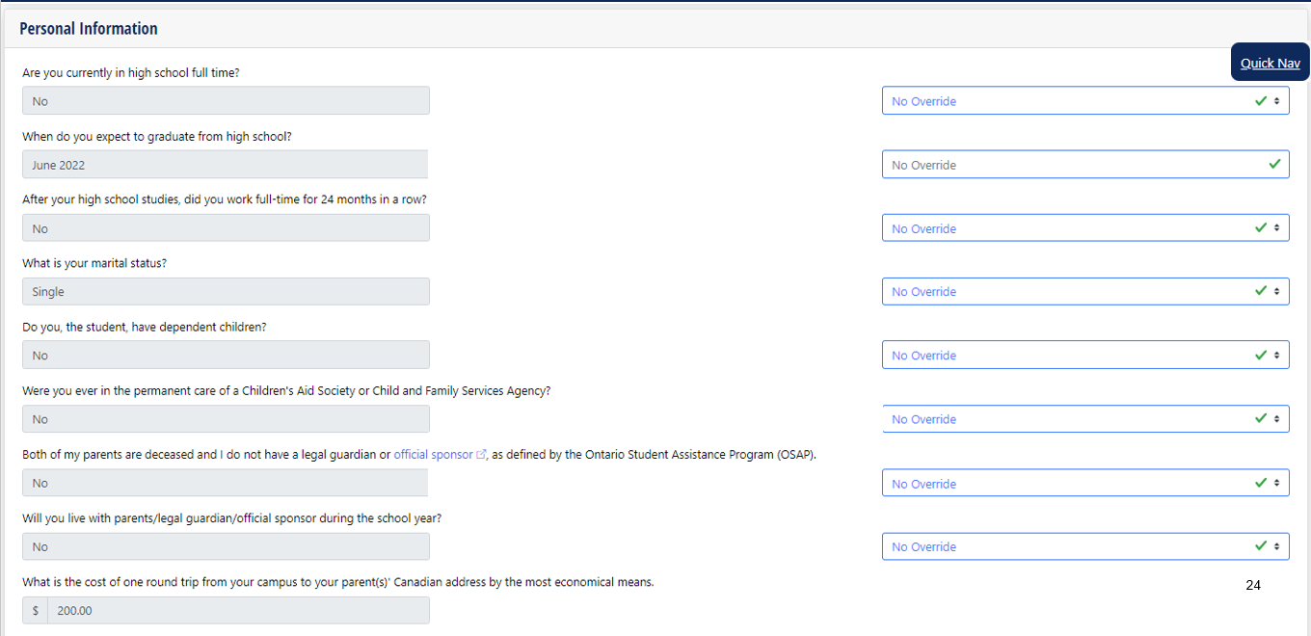

Slide 20
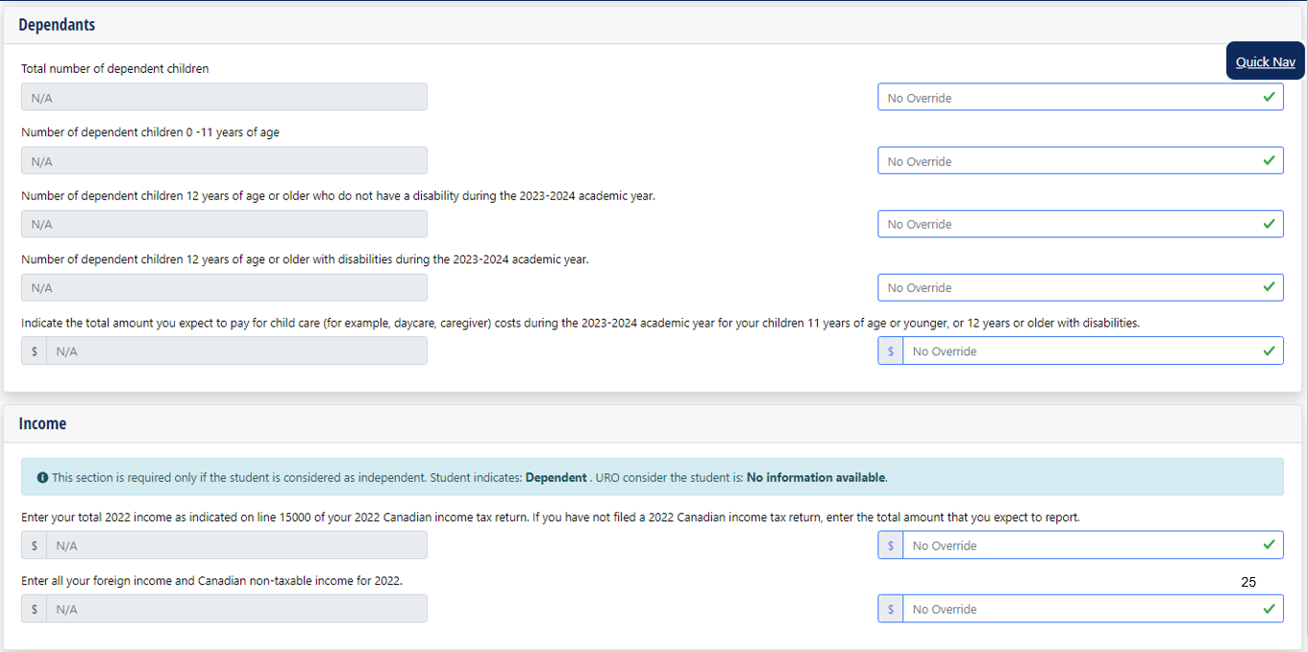

Slide 21
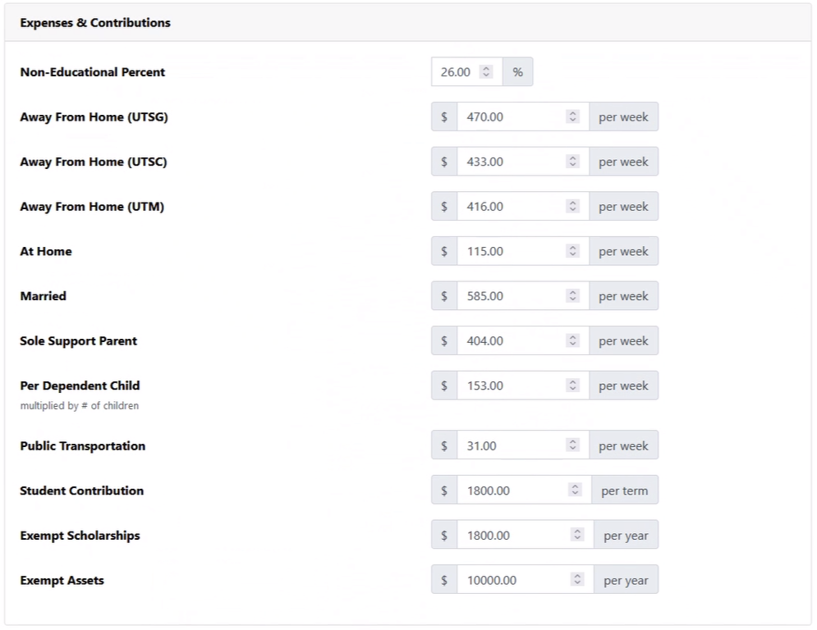

Slide 22
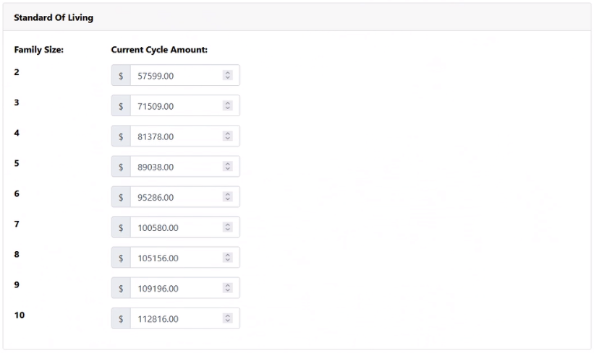

Slide 23
Redesign evaluation: applicant behaviour
For 2023-24 and 2024-25, a series of internal evaluations are being conducted to assess student interaction with the redesigned UTAPS program
Results will be used to evaluate the effectiveness of the redesign and make future improvements
2023-24
Are certain students more likely than others to complete a financial need application?
Can students be incentivized to complete an application early (e.g., before the start of classes)?
2024-25
Does early funding information, including a minimum guarantee, influence a student's decision to accept an offer of admission, especially if the information is provided around the time a student receives an admission offer?

Slide 24
What's Next?
2024-25 – Redesign: Phase II
Application launch: March 11, 2024
First-year, direct-entry, undergraduate students, who applied by May 1st, have been assessed for: UTAPS Estimate and Minimum Guaranteed Amount (MGA): 2,605 students
One program only
Accepted admission offer; or, first/top choice on OUAC application, if no offer accepted by May 1st
UTAPS Estimate: if financial need, $100 or more
MGA: if Estimate, $500 or more
For 2024-25, MGA is 100% of the UTAPS Estimate ($2,999 cap); terms and conditions apply
Regular UTAPS cycles will start in the fall term
Beyond 2024-25
Create a Guaranteed Basic UTAPS amount planning tool -- provide users with what they can expect to receive in UTAPS grant funding (current and future students)
Further consolidation of U of T need-based applications into one application
Continue development of U of T financial database

Slide 25
Questions

