Slide 1
Award Selection
Where Equity, Diversity, Inclusion and Accessibility intersect

Slide 2

Joel
Dooley-May
Assistant Registrar, Student Financial Support
CASFAA Regional Director (AB, NU, NWT)
ASAPA Past-President
Member of the Fantastic Four

Slide 3
Agenda
Introduction
Overview of UCalgary
Overview of Student Financial Support @ UCalgary
EDIA @ UCalgary
Roundtable Discussion
  Non-EDIA award selection
  EDIA award development
  EDIA award selection

Slide 4
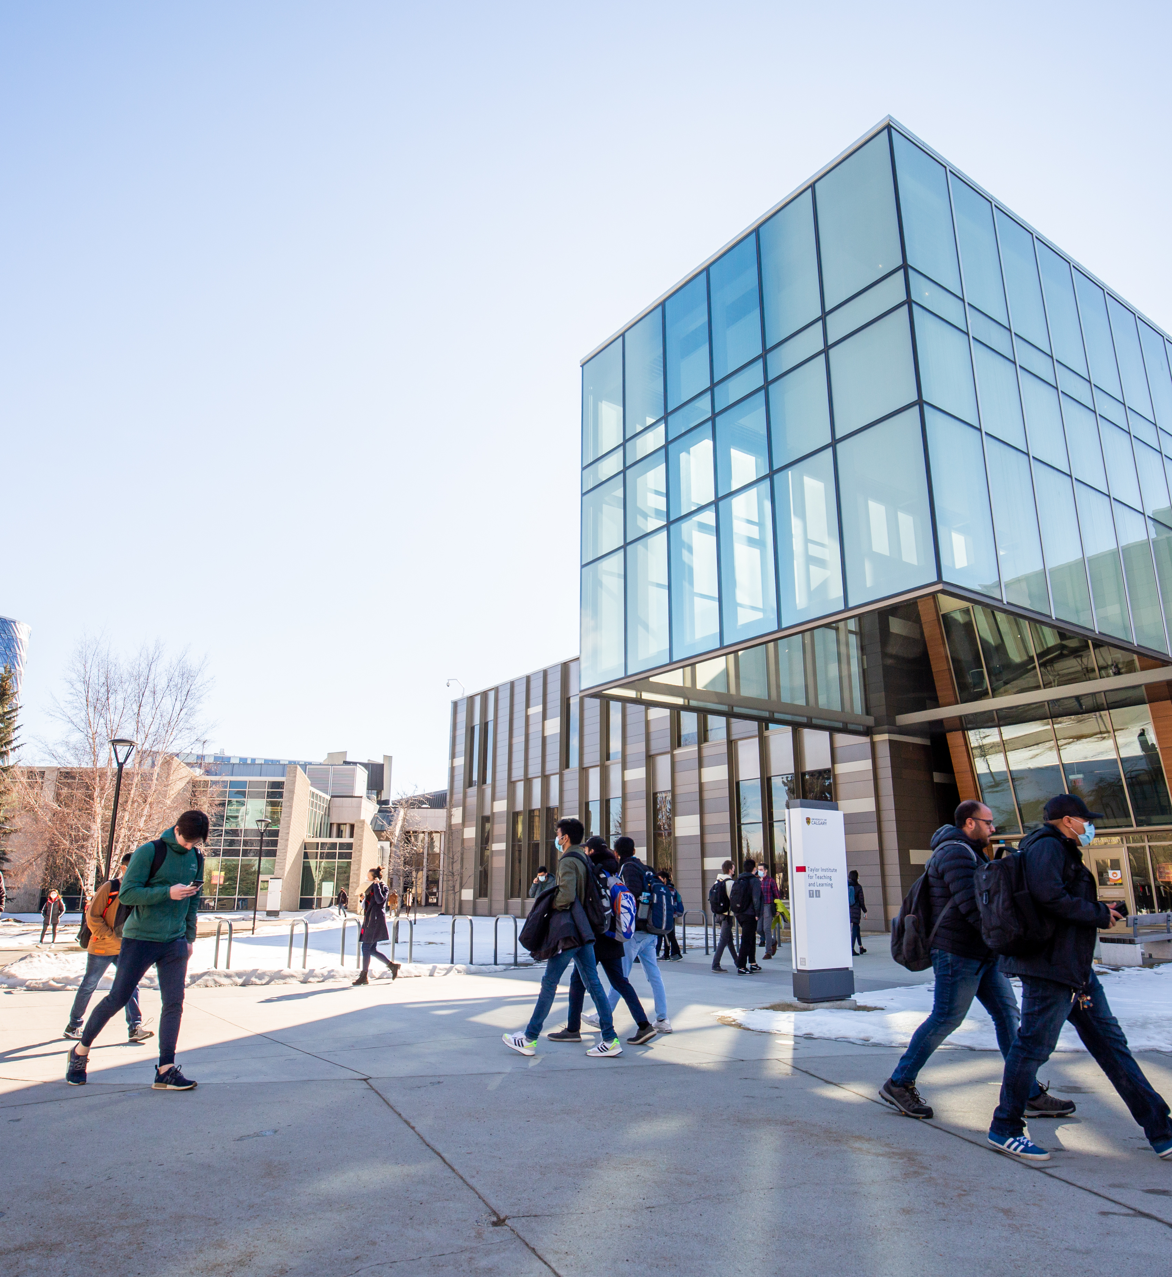
University of Calgary
Home of the Dinos
Founded 1966, with origins in the early 1900s
5 campuses: 4 in the Calgary area and 1 in Doha, Qatar
14 faculties
1,850+ academic staff actively engaged in research, scholarship and teaching
2,900+ non-academic staff focused on operating the institution and delivering against our core mandate
$1.48 billion consolidated budget: estimated economic impact of $16.5 billion to Alberta’s economy
34,000+ students: 26,000+ undergraduates, 8,000 graduate students
217,000+ alumni; 2/3 live or work in the Calgary area

Slide 5
Student Financial Support
Manages all need-based funding for students
  Facilitates the administration of government student loan funding for Canadian citizens, Permanent Residents and International students from the United States of America
  Administers all bursaries
  Manages merit-based Scholarships and awards for all Undergraduate and Professional Faculty students
  Responsible for all Emergency funding
  Leads the institutions Financial Literacy program – Money Smart

Slide 6
Equity, Diversity, Inclusion and Access at UCalgary
Multiple Players in EDIA base award development and operationalization.
Office of Equity, Diversity, and Inclusion
Office of Indigenous Engagement
Office of Development & Alumni
Legal Office
Registrar’s Office (Student Financial Support)

Slide 7
Roundtable Time

Slide 8
Award Selection (non-EDIA)

Slide 9
What steps do you take to in your standard award selection to be inclusive?

Slide 10
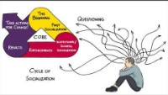

Implicit Bias

Slide 11
How do you deal with Implicit Bias in your award selection?

Slide 12
Reference letters, do you require them?
Why and why not?

Slide 13
EDIA Award Development

Slide 14
EDIA Award Development
Although inclusionary, they are Exclusionary in nature
Must be ameliorative to violate human rights, such as:
  Gender
  Race
  Ethnicity
  Sexual Orientation
  Age
  Place of origin
Due to human rights, development must be approved by Legal

Slide 15
Who has an award(s) that are gender specific?

Slide 16
Who has an award(s) that are age specific?

Slide 17
Who has an award(s) that are race or ethnicity specific?

Slide 18
Who has an award(s) that are place of origin specific?

Slide 19
Who has an award(s) that are place of origin specific?

Slide 20
Who has an award(s) that are sexual orientation specific?

Slide 21
What is involved in the development of any new EDIA based awards at your institution?

Slide 22
Do you feel you currently have any awards that might be stretching the amelioration of human rights?

Slide 23
Are your EDIA based awards balanced between merit and need-based?

Slide 24
EDIA Award Selection

Slide 25
What equity-deserving populations do you currently select for?

Slide 26
Who determines the questions in your application when it comes to equity and inclusion?

Slide 27
How do you verify self-disclosures?

Slide 28
Do you utilize any outside departments to verify EDIA eligibility?

Slide 29
Are your EDIA based awards balanced between merit and need-based?

Slide 30
What would you define as best practices regarding EDIA award selection?

Slide 31
Is there anything else you would like to discuss?

Slide 32
Thank you for Participating.

