Slide 1
FINANCIAL Resources and tools for students
CASFAA 2018 Conference
May 29, 2018

Slide 2
RESSOURCES ET OUTILS FINANCIERS POUR LES ÉTUDIANTS
Conférence de l’ACRAFE 2018
29 mai 2018

Slide 3
FCAC – Who we are
Government agency; founded in 2001
Ensure FRFIs comply with consumer protection measures
Promote consumer education
Raise awareness of rights and responsibilities
Strengthen financial literacy of Canadians
Empower individuals to make informed financial decisions

Slide 4
L’ACFC – Qui sommes-nous?
Agence gouvernementale fondée en 2001
Veiller à ce que les IFF respectent les mesures de protection des consommateurs
Promouvoir l’éducation des consommateurs
Faire connaître les droits et les responsabilités
Renforcer la littératie financière des Canadiens
Permettre aux gens de prendre des décisions financières éclairées

Slide 5
Educational tools and resources
Services and information
Free online tools and calculators
Educational programs

Slide 6
Ressources et outils éducatifs
Services et information
Outils et calculatrices offerts gratuitement en ligne
Programmes éducatifs

Slide 7
Online tools and calculators
Budget calculator
Financial Goal Calculator
Comparison Tools
Account Comparison Tool
Credit Card Comparison Tool
Credit Card Payment Calculator

Slide 8
Outils et calculatrices en ligne
Calculatrice budgétaire
Calculatrice d’objectifs financiers
Outils de comparaison
Outil de comparaison des comptes
Outil de comparaison des cartes de crédit
Calculatrice de paiements de carte de crédit

Slide 9
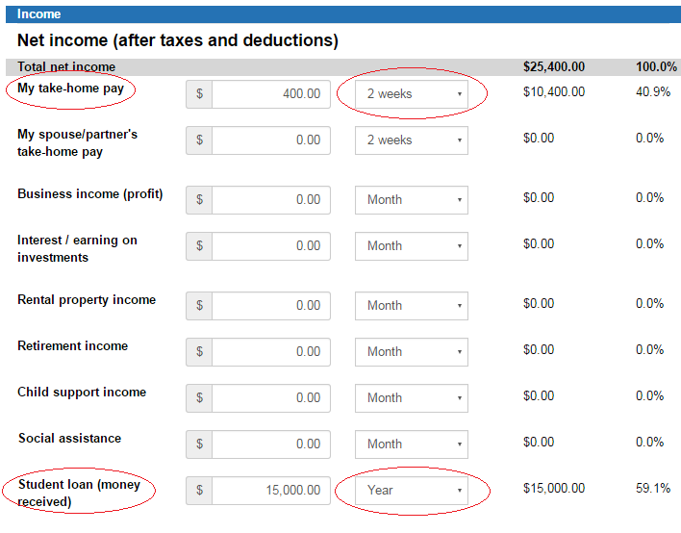
Budget Calculator

Slide 10
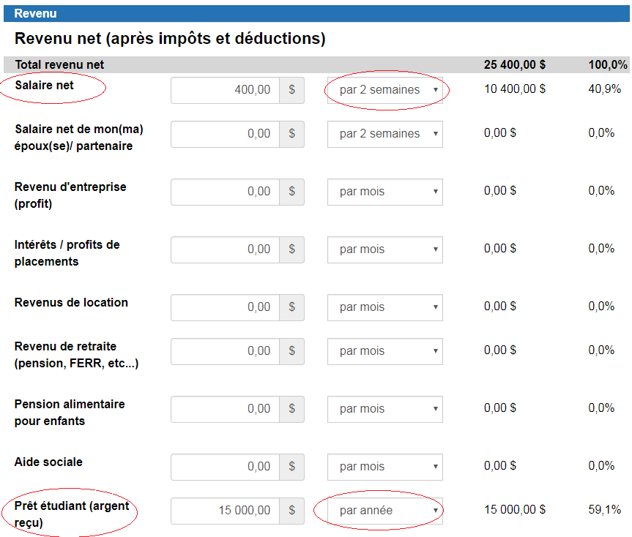
Calculatrice budgétaire

Slide 11
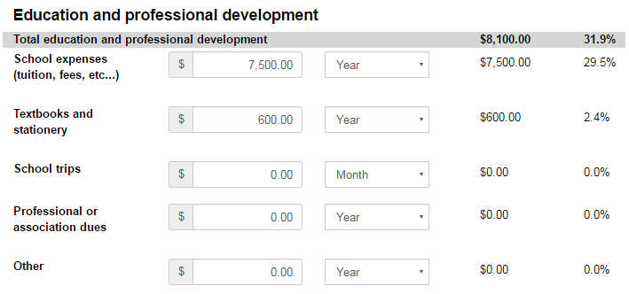
Budget Calculator

Slide 12
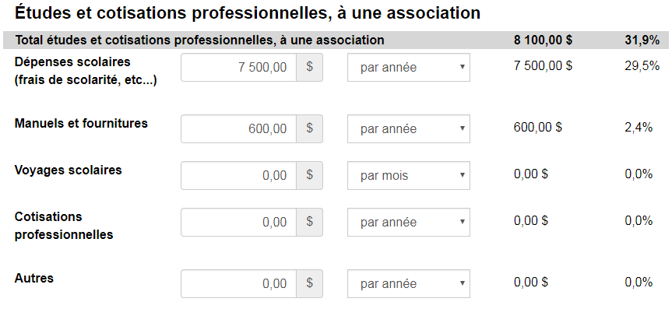
Calculatrice budgétaire

Slide 13
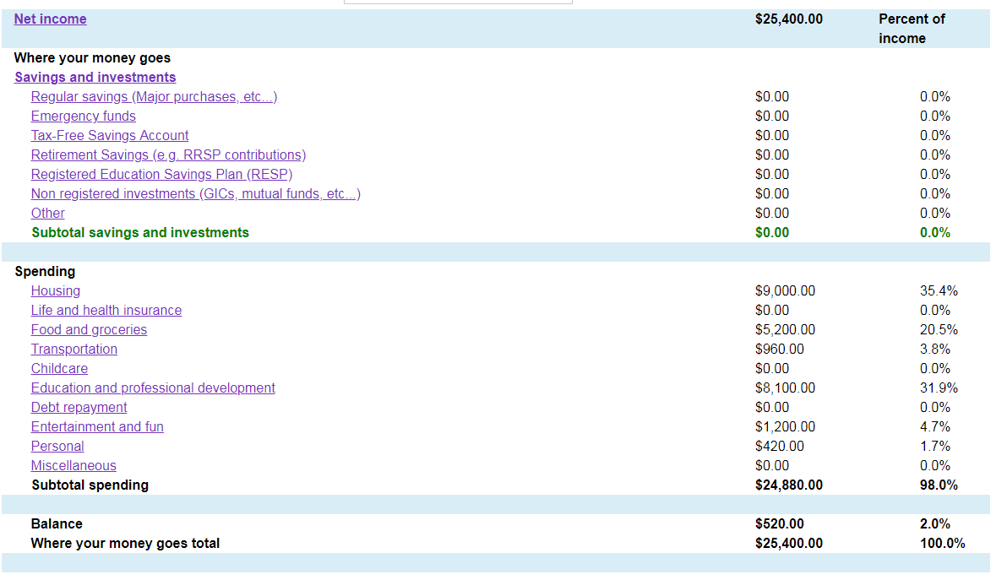
Budget Calculator

Slide 14
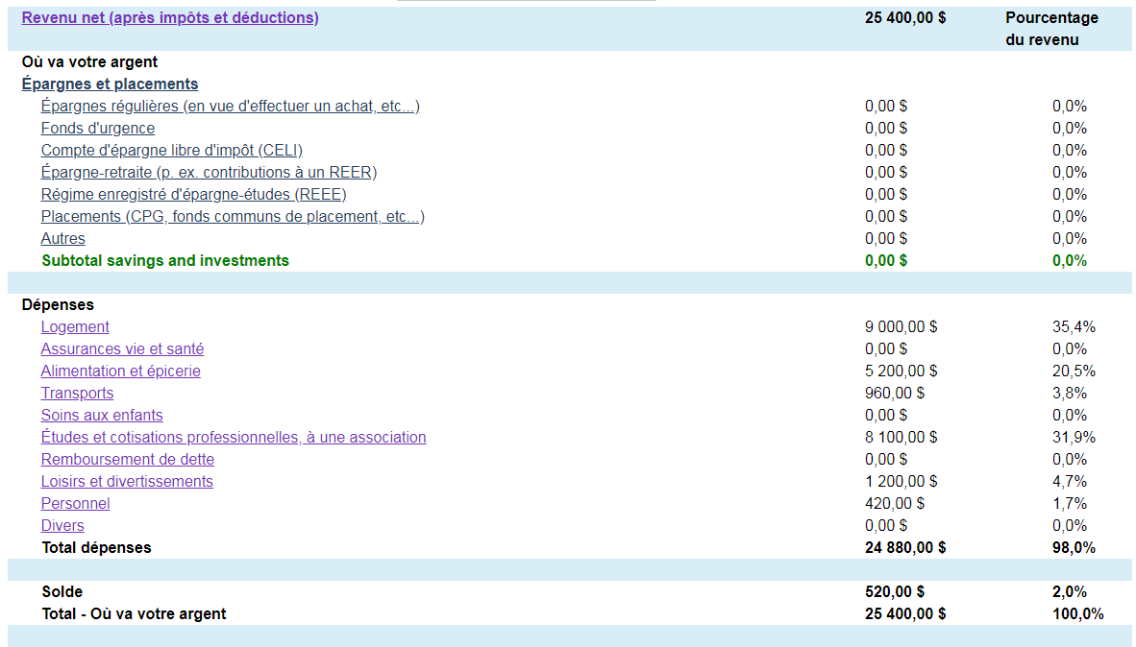
Calculatrice budgétaire

Slide 15
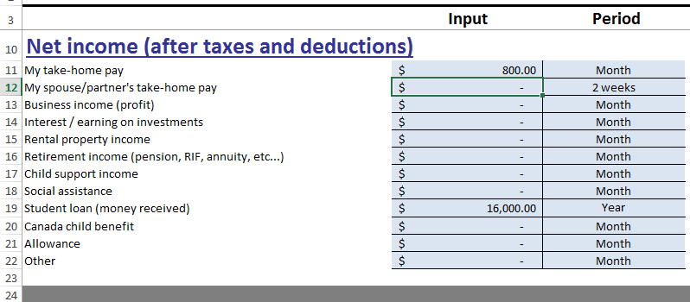
Budget Calculator (Excel)

Slide 16
Calculatrice budgétaire (Excel)

Slide 17
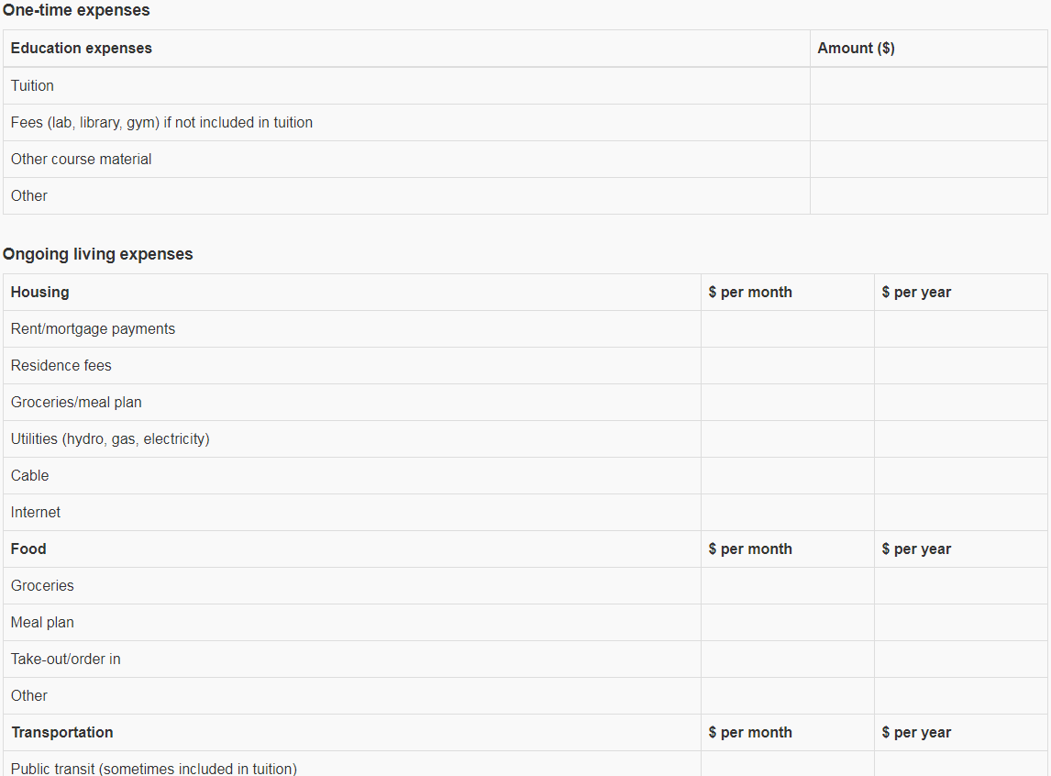
Student Budget Worksheet (online)

Slide 18
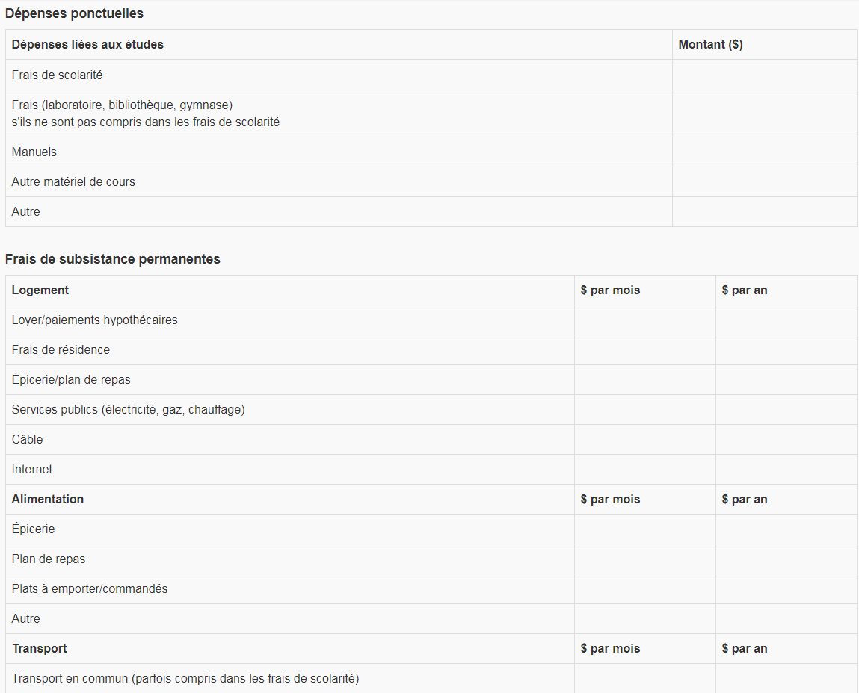
Grille pour un budget étudiant (en ligne)

Slide 19
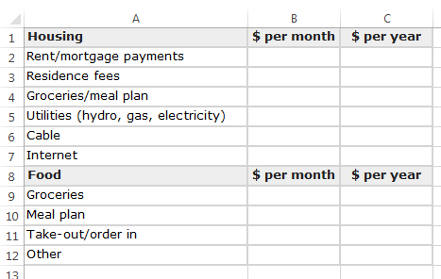
Student Budget Worksheet (Excel)

Slide 20
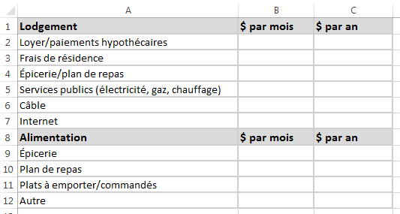
Grille pour un budget étudiant (Excel)

Slide 21
Financial Goal Calculator

Slide 22
Calculatrice d’objectifs financiers

Slide 23
Financial Goal Calculator

Slide 24
Calculatrice d’objectifs financiers

Slide 25
Financial Goal Calculator

Slide 26
Calculatrice d’objectifs financiers

Slide 27
Financial Goal Calculator

Slide 28
Calculatrice d’objectifs financiers

Slide 29
Account Comparison Tool

Slide 30
Outil de comparaison de comptes

Slide 31
Account Comparison Tool

Slide 32
Outil de comparaison de comptes

Slide 33
Account Comparison Tool

Slide 34
Outil de comparaison de comptes

Slide 35
Credit Card Comparison Tool

Slide 36
Outil de comparaison de cartes de crédit

Slide 37
Credit Card Comparison Tool

Slide 38
Outil de comparaison de cartes de crédit

Slide 39
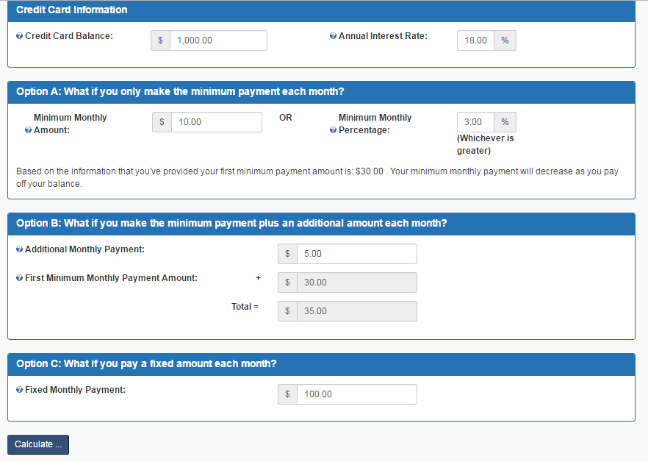
Credit Card Payment Calculator

Slide 40
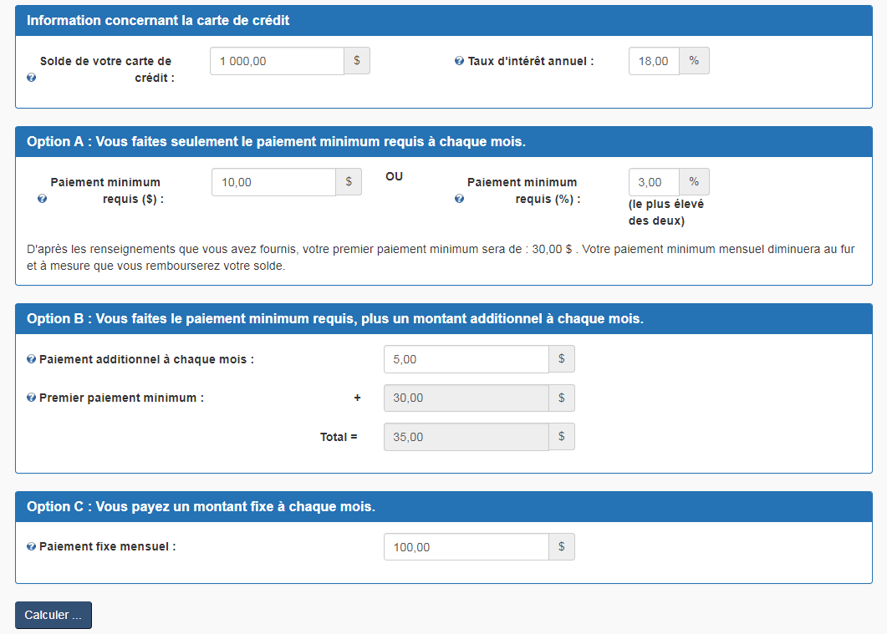
Calculatrice de paiements de carte de crédit

Slide 41
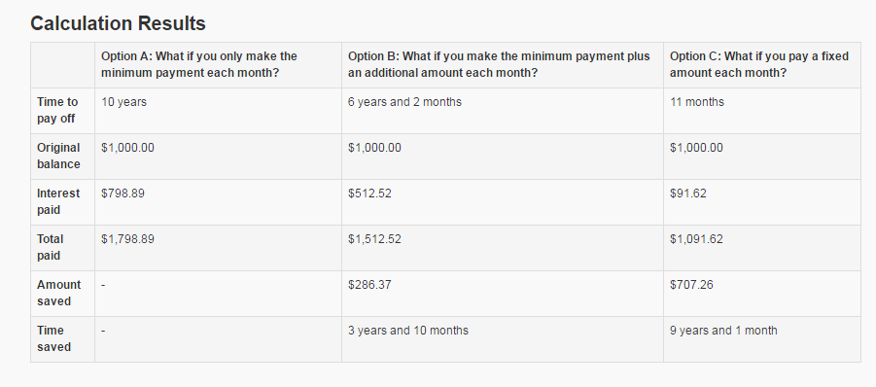
Credit Card Payment Calculator

Slide 42
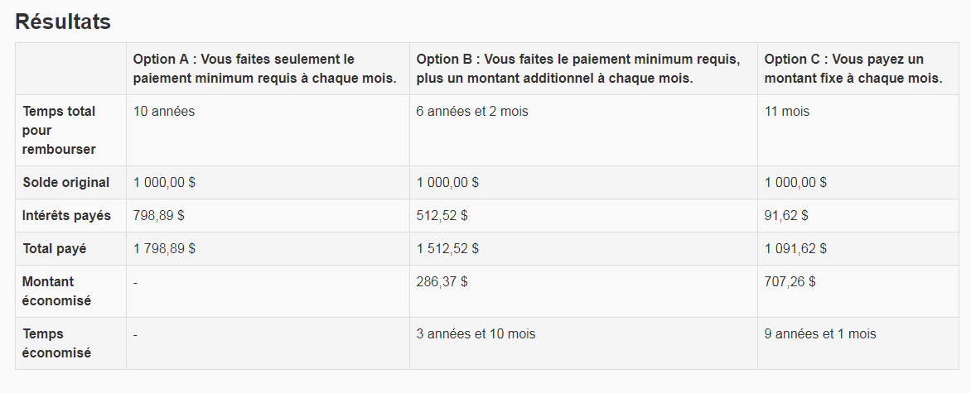
Calculatrice de paiements de carte de crédit

Slide 43
Online educational content
Managing your money
Renting your first apartment
Debt and borrowing
Education funding

Slide 44
Contenu éducatif en ligne
Gérer votre argent
Louer votre premier appartement
Dettes et emprunts
Financement des études

Slide 45
Managing your money

Slide 46
Gérer votre argent

Slide 47
Renting your first apartment

Slide 48
Louer votre premier appartement

Slide 49
Debt and borrowing

Slide 50
Dettes et emprunts

Slide 51
Education funding

Slide 52
Financement des études

Slide 53
Canadian Financial Literacy Database
One-stop shop for financial literacy resources, events, programs, etc.
Currently 1,300+ resources from 170+ organizations
Resources for students and youth

Slide 54
Base de données canadienne sur la littératie financière
Guichet unique pour les ressources, les événements, les programmes, etc., en matière de littératie financière
À l’heure actuelle, plus de 1 300 ressources provenant de plus de 170 organismes
Ressources pour les étudiants et les jeunes

Slide 55
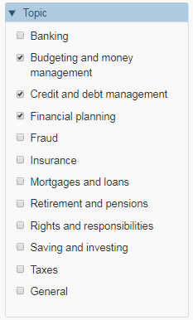
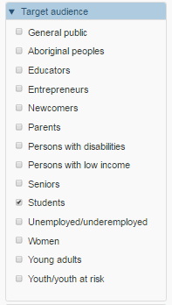
Canadian Financial Literacy Database

Slide 56
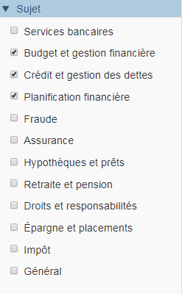
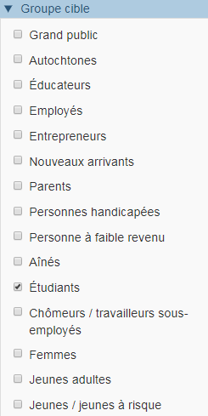
Base de données canadienne sur la littératie financière

Slide 57
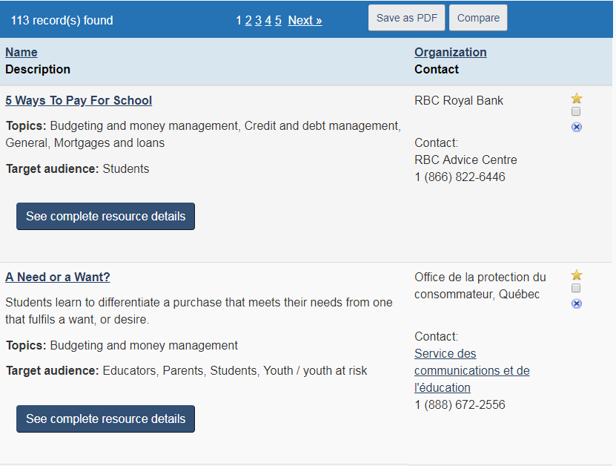
Canadian Financial Literacy Database

Slide 58
Base de données canadienne sur la littératie financière

Slide 59
Interactive workshops and educational programs
Credit reports and scores workshop
Financial Basics
Your Financial Toolkit

Slide 60
Ateliers interactifs et programmes éducatifs
Atelier sur les dossiers et les cotes de crédit
Finances personnelles – notions de base
Votre boîte à outils financiers

Slide 61
Credit reports and scores workshop
45-minute interactive workshop
Slides and facilitator’s guide
Provide an overview of credit reports and scores
Credit report and score basics
What’s included
How they’re used
Factors in credit score
Checking your credit report
What to look for
How to correct errors

Slide 62
Atelier sur les dossiers et les cotes de crédit
Atelier interactif de 45 minutes
Diapositives et guide de l’animateur
Présenter un aperçu des dossiers et des cotes de crédit
Dossiers et cotes de crédit – notions de base
Contenu
Comment les utiliser
Facteurs relatifs aux cotes de crédit
Consulter votre dossier de crédit
Ce qu’il faut chercher
Comment corriger les erreurs

Slide 63
Understanding your credit report workshop

Slide 64
Atelier pour comprendre votre dossier de crédit

Slide 65
Financial Basics
Financial workshop aimed at young adults
Teaches about saving, budgeting, credit and more
Consists of:
Presenter’s manual
Participants’ handbooks
Presentation slides
Notes:
Developed by FCAC and Investor Education Fund
Informative and interactive
88 slides, 54 page handbook
Can be delivered in about half a day, but is modular so you can customize based on availability/needs

Slide 66
Finances personnelles – notions de base
Atelier destiné aux jeunes adultes
Traite de l’épargne, de l’établissement du budget, du crédit et d’autres choses
Composition
Manuel de l’animateur
Manuels des participants
Diapositives de présentation

Slide 67
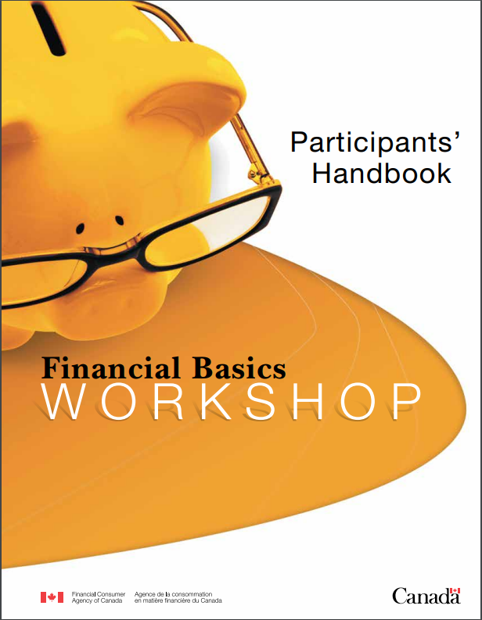
Financial Basics

Slide 68
Finances personnelles

Slide 69
Your Financial Toolkit
Modular learning program to help adults make better financial decisions
Modules include:
Income, expenses and budget
Saving
Credit and debt management
Notes:
12 modules total
Each module contains tools like videos, interactive worksheets, calculators, etc to help practice financial skills and apply financial concepts
Updates have been made to provide training material targeted at students; should be available as of start of conference
CASFAA members helped to review and provide examples that would be relevant for students
2nd update being worked on related to credit and debt management; timing unknown

Slide 70
Votre boîte à outils financiers
Programme modulaire d’apprentissage visant à aider les adultes à prendre de meilleures décisions financières
Les modules comprennent :
Revenus, dépenses et budget
Épargne
Crédit et gestion des dettes

Slide 71
Your Financial Toolkit

Slide 72
Vos outils financiers

Slide 73
Your Financial Toolkit

Slide 74
Vos outils financiers

Slide 75
Money Fit Challenge
www.moneyfitchallenge.com
Notes:
MoneyFit Challenge is a free, online, incentive based, educational endeavour to help Canadians learn more about money matters and take important small steps to improve their own personal financial well-being.
The challenge is offered free of charge. Participants can earn points for prizes by completing learning activities about budgeting, saving, borrowing, debt and about their rights and responsibilities when it comes to money matters. The challenge is available in both English and French. The material is presented in an engaging format, which includes FCAC’s videos, tools and written materials, supplemented by more information should users wish to learn more about a topic. Participants can use the points they earn to bid on chances to win prizes (various gift cards).
The Challenge is also aimed at University/ College students. The Challenge offers additional targeted content and relevant prizes to students when registering as a student. University/ College administrators can offer financial education to their institution’s students at no cost and with little effort from a resources perspective as the challenge offers turnkey promotional resources. In addition, when a University/College administrator registers, they are listed on a viewable trailblazer board on the homepage and earn points that are distributed to their participants by administering the challenge and doing certain activities such as promoting the challenge to their participants.

Slide 76
Défi ma santé financière
www.moneyfitchallenge.com/fr
Notes:
MoneyFit Challenge is a free, online, incentive based, educational endeavour to help Canadians learn more about money matters and take important small steps to improve their own personal financial well-being.
The challenge is offered free of charge. Participants can earn points for prizes by completing learning activities about budgeting, saving, borrowing, debt and about their rights and responsibilities when it comes to money matters. The challenge is available in both English and French. The material is presented in an engaging format, which includes FCAC’s videos, tools and written materials, supplemented by more information should users wish to learn more about a topic. Participants can use the points they earn to bid on chances to win prizes (various gift cards).
The Challenge is also aimed at University/ College students. The Challenge offers additional targeted content and relevant prizes to students when registering as a student. University/ College administrators can offer financial education to their institution’s students at no cost and with little effort from a resources perspective as the challenge offers turnkey promotional resources. In addition, when a University/College administrator registers, they are listed on a viewable trailblazer board on the homepage and earn points that are distributed to their participants by administering the challenge and doing certain activities such as promoting the challenge to their participants.

Slide 77
Carrot Rewards
FCAC conducted a pilot to explore opportunities to enhance financial literacy using mobile technology applications.
The pilot focused on one area of sound financial management: budgeting
Notes:
Carrot Rewards is a mobile application that encourages Canadians to adopt healthier lifestyles. The vision for wellness includes financial well-being
Specifically, Carrot Rewards offers consumers loyalty reward points (Aeroplan Miles, Petro-Points, Scene, More Rewards—a Western Canada loyalty program) in exchange for performing simple tasks, such as reading short texts, taking basic quizzes, and watching short videos. The application has been developed by Social Change Rewards (SCR), a private Canadian company, with a grant from the Public Health Agency of Canada (PHAC). This initiative is part of the Government of Canada multisector approach to promote healthy living and prevent chronic diseases.
Financial stress can be very detrimental to someone’s health. It’s important that Canadians be equipped with the knowledge, confidence and the skills they need to manage their personal finances and improve their financial well-being. A mobile application is an innovative tool that can be used to help support Canadians towards that goal and assist in measuring the impact.
Why budgeting: Based on the findings of the CFCS, we know that too few Canadians have a budget (46%). But of those who did, the majority (93%) stuck to it. For this reason, we developed a pilot project to test the impact of FCAC’s consumer education materials related to budgeting.
What did FCAC hope to achieve through the Carrot Rewards app? FCAC wanted to test whether its consumer education material enhanced knowledge, confidence, attitudes, and behaviours related to budgeting, one of the basic tools of greater financial well-being. Over the course of a month, we sent a series of consumer education messages, quizzes and questions to consumers and we tracked how they responded. And, of course, we compared them to a control group to measure impact.
How will the Carrot Rewards app improve budgeting? Each intervention builds knowledge about budgeting among users. Interventions use plain language and concrete examples (e.g., how much a daily coffee costs per year) to demonstrate how a budget can help set priorities, keep spending in line and increase one’s savings. Behavioural insights such as call-to-action statements were used to encourage users to create a budget using FCAC’s budgeting tool and to visit FCAC’s related online resources.

Slide 78
Carrotte points santé
L’ACFC a mené un projet pilote pour étudier les possibilités d’améliorer la littératie financière au moyen d’applications de technologie mobile.
Le projet pilote a ciblé un aspect de la bonne gestion financière : l’établissement d’un budget.

Slide 81
Darren Brothers
Consumer Education Officer
darren.brothers@fcac.gc.ca
613-960-4676
Julie Hauser
Partnership and Stakeholder Engagement Officer
julie.hauser@fcac.gc.ca
613-954-1926

Slide 82
Darren Brothers
Agent, Éducation des consommateurs
darren.brothers@acfc.gc.ca
613-960-4676
Julie Hauser
Agent, Partenariat et engagement des intervenants
julie.hauser@acfc.gc.ca
613-954-1926

